Slide 1
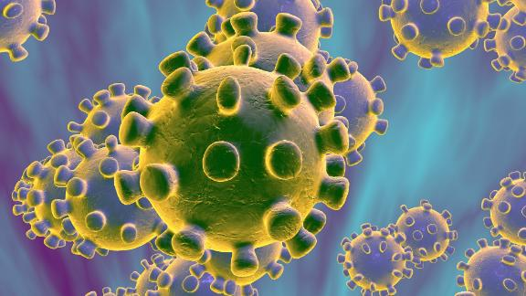
MyEDPO
Data Protection Officer Services
Notes:
Thank you Carmen and Gabriella at the EABH.
I’m starting with a prayer for the sick, and a moment of respect for the medical professionals who are struggling, and putting themselves in harm’s way. We owe them so a great deal, and I want to start by recognizing that.
Data protection is not the greatest concern; people’s health is. But as data protection professionals, this is what we know and can affect.
This is NOT legal advice…

Slide 2
Agenda
Theory to Practice…
Data & Pandemics
GDPR & Corona
Functioning with Covid
Questions
Notes:
(1) Data and Pandemics
Lessons learned from the Ebola outbreak
The need for massive data sharing
The Open COVID-19 Data Curation Group
(2) GDPR and Corona
Vital interest and epidemics
Public interest and public health
International transfers
(3) FUNCTIONING WITH COVID.
How do we protect the health and privacy of our employees and site visitors?
Can we collect medical data?
Big4 office entrance
Medical research and Apps
‘My home is my castle' - Quarantine and privacy

Slide 3
Agenda
We’re getting started…
Data & Pandemics
GDPR & Corona
Functioning with Covid
Questions

Slide 4
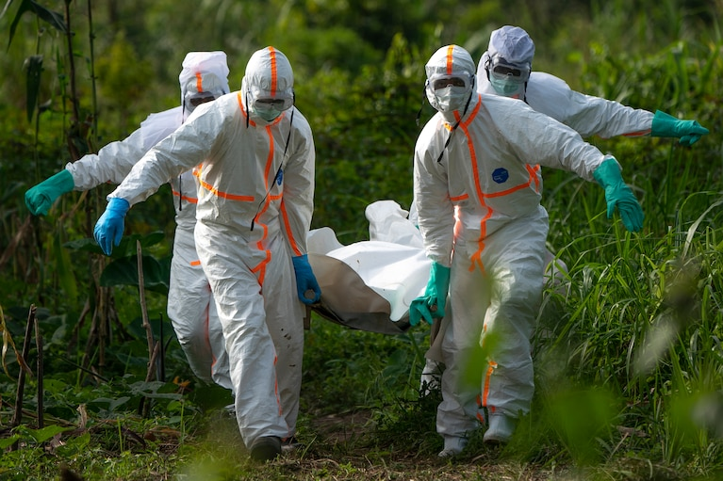
Notes:
In 2014, a small outbreak of Ebola in West Africa – initially in Guinea. But then also Liberia, Sierra Leone, DRCongo, and Mali, even Italy, the US and elsewhere. This quickly became a global health crisis. Over the next 18 months, 30,000 people were infected and over 30% of those died.
One of the important uses of Big Data in combatting Ebola was CDRs – Call Detail Records.
Sean McDonald: https://cis-india.org/papers/ebola-a-big-data-disaster

Slide 5
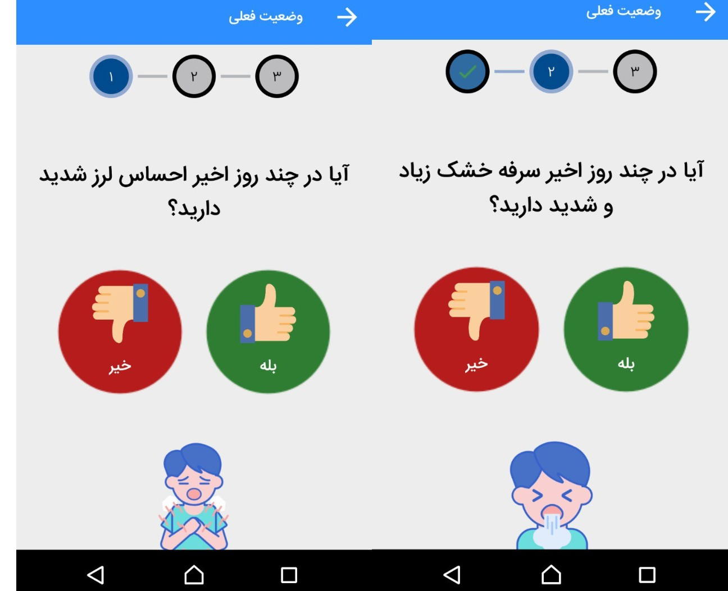
Notes:
The Iranian government encouraged the population to install an app, called AC19, to help determine if they have Coronavirus, if they need quarantine, if they ought to go to hospital, etc.
Activitsts exposed this, but not before 3.5M people had installed it, shared personal data, location data, and who knows what else with a psychotic government.
China has done a lot of similar big data use.

Slide 6
Notes:
Tracetogether is a Singapore government app, which keeps track of all phones that
Phones exchange anonymized IDs; if someone is found positive, TraceTogether can then announce to any phone that was within Bluetooth distance. No private data is shared.

Slide 7
Notes:
Ironically, my own state of Israel has now approved the internal security organization, the Shabak, to track citizens. It is not clear exactly what they’ve been authorized to do (note: after the webinar it was clarified in an open hearing at the Knesset committee, on March 26); presumably to at least track location, and who was in contact with whom, so they can track potential infections and spread, and bring people to quarantine. Israel is a robust democracy, so there’s no fear of it being used for, say, crushing political dissent, but when you give lots of data to a big organization, it’s hard to believe they’ll delete it when they’re done.
Dr Itamar Zilberman, he’s an obstetrician in Tel Aviv. He was feeling unwell, so went to get checked for Corona, since obviously he’s in contact with many pregnant women, who are considered at risk. He went into isolation for 48 hours, until he got his result which was negative. No corona. All the same, everyone who came close to him in the previous two weeks was sent to isolation: including a neighbor who left him a cake outside his apartment. Go figure.
Hopefully there are many fewer mistakes than cases saving people from spreading Corona, but the implications for privacy are worrying.
The Supreme Court is supposed to examine this by Tuesday, and part of the problem is of course that there isn’t really a government in Israel at the moment…
https://www.themarker.com/news/health/1.8698612

Slide 8
Hamagen – The Shield
Notes:
Israel has had several very interesting privacy issues with Corona in the last few days. Shabak – discussed above.
Israel’s MoH has produced an app, and launched it yesterday. Called Hamagen. MoH’s policy claims that all data remains on-device. And that the data is not shared unless (i) you are positively diagnosed with Coronavirus, and (ii) you consent to transfer the data to the MoH. Been reviewed by some privacy experts and found to be more than adequate in protecting privacy.
https://govextra.gov.il/ministry-of-health/hamagen-app/terms-and-conditions-of-use-en/?utm_source=go.gov.il&utm_medium=referral

Slide 9
Agenda
Moving from pandemics and data, to GDPR provisions
Data & Pandemics
GDPR & Corona
Functioning with Covid
Questions

Slide 10
Article 9(2)(c): …processing is necessary to protect the vital interests of the data subject or of another natural person where the data subject is physically or legally incapable of giving consent
Vital Interest
GDPR anticipated this. Amazingly.
Notes:
With the scary spread of COVID-19, data protection is not typically everyone’s number-one concern, and rightly so. But now we examine the GDPR building blocs, and we’ll get more practical in a few minutes.
The single most important point in GDPR terms is the Article 6(1)(d) which states that processing is lawful if “necessary in order to protect the vital interests of the data subject or of another natural person.”
For special categories of data, Article 9(2)(c) similarly provides that processing is lawful where “necessary to protect the vital interests of the data subject or of another natural person where the data subject is physically or legally incapable of giving consent.”
Hospitals, researchers, ministries of health, law enforcement and others within countries and across borders are sharing data on an unprecedented scale in order to stave the spread of COVID-19, and best practice indicates the massive unfettered sharing of data is critical (see Lancet article by Heymann). In China, health authorities and a range of other relevant organizations such as airlines, rail operators, and property management companies, have been sharing data to help identify people who have come in contact with infected persons and may be spreading the disease. Along the way there have reportedly been a number of data breaches, and the Chinese data protection authority issued clarifications in this regard, highlighting the purpose limitation of such data processing, and the importance of protecting privacy to the extent possible while using the data for disease prevention.
The notion of ‘incapable of giving consent’ has, as far as I can tell, been largely skipped over.
And the interest of ‘another person’ mean that even if I’m cured from Corona, or am not at risk, there could still be a vital interest in processing my health data.
David L Heymann ‘Data sharing and outbreaks: best practice exemplified’ 395 Lancet 469-470, February 15, 2020. https://www.thelancet.com/action/showPdf?pii=S0140-6736%2820%2930184-7
https://www.dataprotectionreport.com/2020/02/personal-data-protection-in-the-time-of-coronavirus-covid-19/
http://www.cac.gov.cn/2020-02/09/c_1582791585580220.htm

Slide 11
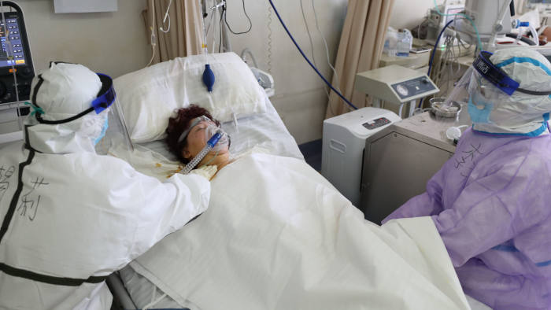
Vital Interest
GDPR anticipated this. Amazingly.
Recital 46: …Some types of processing may serve both important grounds of public interest and the vital interests of the data subject as for instance when processing is necessary for humanitarian purposes, including for monitoring epidemics and their spread or in situations of humanitarian emergencies, in particular in situations of natural and man-made disasters.
Notes:
Recital 46 makes it clear that “monitoring epidemics and their spread” is a Vital Interest. Even if I’m not sick, and I have a small chance of getting nasty symptoms.
Data sharing is critical for us all…

Slide 12
Article 9(2)(g): …“necessary for reasons of substantial public interest, on the basis of Union or Member State law”.
Public Interest
GDPR anticipated this. Amazingly.
Notes:
GDPR allows member states and union law to derogate from the prohibition on processing special categories for personal data (Recital 52), not for any public interest, but for substantial public interest, such as:
“…the prevention or control of communicable diseases and other serious threats to health.”
In other words, prevention of communicable diseases are suitable grounds for member states to derogate from the Article 9 prohibition. In that spirit, the Irish Data Protection Act 2018, section 53 states:
“the processing of special categories of personal data shall be lawful where it is necessary for public interest reasons in the area of public health including… protecting against serious cross-border threats to health”.
In other words, Article 9(2)(g) will apply in the present instance. The UK’s Data Protection Act 2018 adds a caveat (Schedule 1, Part 1, section 3): the processing must be “necessary for reasons of public interest in the area of public health, and is carried out (i) by or under the responsibility of a health professional, or (ii) by another person who in the circumstances owes a duty of confidentiality under an enactment or rule of law.” So under the UK’s DPA the substantial public interest basis in such a case may only be claimed by a health professional or another person with statutory confidentiality requirements. Airlines, for example, may not be able to rely on this basis.

Slide 13
International Transfer
GDPR anticipated this. Amazingly.
Article 49(1)(d) Recital 112: “public health, for example in the case of contact tracing for contagious diseases...”.
Notes:
International transfer: the REQUIRED data sharing is not just regional or national, but cross-border. This was anticipated by GDPR in Article 49(1)(f), which allows international transfer with no other mechanism (standard contractual clauses, adequacy etc) for protection of vital interests. Article 49(1)(d) provides a ‘public interest’ derogation, and Recital 112 explains that member states' derogations in the public interest could include transfers made for reasons of “public health, for example in the case of contact tracing for contagious diseases...”. So GDPR has a mechanism to enable not only massive sharing of personal data for fighting COVID-19, but also cross-border sharing.

Slide 14
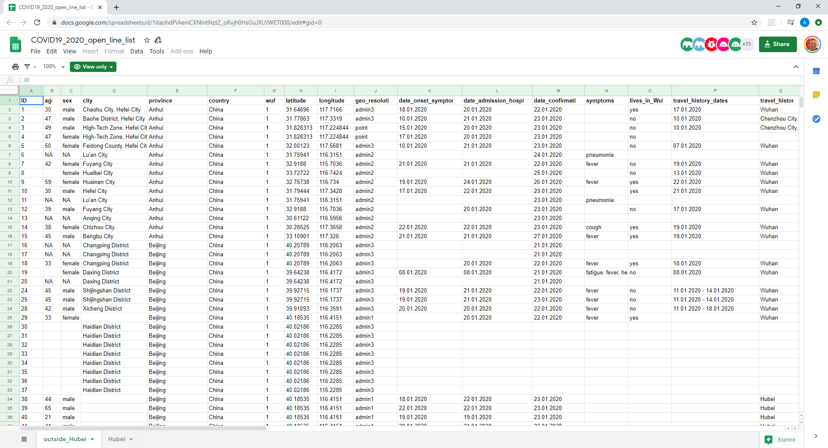
Notes:
Aside from organizations sharing data directly, there have been several initiatives to make data readily available to anyone with an interest. The Open COVID-19 Data Curation Group has built a centralized repository of information on confirmed COVID-19 patients. The repository is hosted in a Google sheet, open to the public, and contains age, location, gender, symptoms, onset dates, travel history. For example, one database states (the details are slightly modified to make them false and not re-identifiable) that a 32 year-old female from a town in Reggio Emilia, in Italy, tested positive, on her return from China on February 3, 2020, and had eye-irritation and fever. In light of much research on re-identifiability of data, and WP29’s Opinion 216, it seems probable that the true record is pseudonymous, not anonymous. The population of the town is currently around 10,000, so re-identification ought to be fairly straightforward.[4]
The data is shared publicly because of the enormous benefits to mankind from accessing this data. However, it is still personal health data, and is governed by the ‘vital interest’ lawful basis. This means, for example, that using the data would only be lawful to someone acting in the vital interests of the data subjects or others; prurience and curiosity would not constitute a vital interest, and nor, presumably, would writing data protection insights on COVID-19.
The Open COVID-19 Data Curation Group database states: “Information is collated from a variety of sources, including official reports from WHO, Ministries of Health, and Chinese local, provincial, and national health authorities. If additional data are available from reliable online reports, they are included. Data are available openly and are updated on a regular basis (around twice a day).”
GDPR seems to have expressly contemplated this kind of processing. In particular, GDPR Recital 46 states that the vital interest lawful basis may apply “for monitoring epidemics and their spread”.
That’s relevant for epidemiologists, hospitals, the state.
What about companies? What about us as employers? That’s the next section…
https://www.thelancet.com/journals/laninf/article/PIIS1473-3099(20)30119-5/fulltext

Slide 15
Agenda
This is where we discuss how it really affects us, and what we must do
Data & Pandemics
GDPR & Corona
Functioning with Covid
Questions
Notes:
Let’s get practical:
What can we and what can we not do with our employees and staff?
Several authorities have given their opinions on this in recent days.
The Swedish Authority has clarified that :
What IS personal health information? The fact that someone has coronavirus IS personal health information. That’s obvious really.
What is NOT personal health information?
The fact that an employee has returned from a so-called risk area is NOT considered a personal health information.
The fact that an employee is in "quarantine“ is NOT, unless it contains more detailed information about the cause.
https://www.datainspektionen.se/nyheter/coronavirus-och-personuppgifter/
In the meantime, many other authorities (and a day after the Webinar, the Israeli registrar too) have issued guidance. Can’t summarize it all, but will provide some highlights here.

Slide 16
Functioning with Covid-19
Eight Highlights
Transparency
Lawful basis
Security
Confidentiality
Accountability
Data minimization
Data Mapping
Privacy Policy
Notes:
Irish data protection authority in the Irish context of course:
“…Employers also have a legal obligation to protect their employees under the Safety, Health and Welfare at Work Act 2005 (as amended). This obligation together with Article 9(2)(b) GDPR provides a legal basis to process personal data, including health data, where it is deemed necessary and proportionate to do so...”

Slide 17
Functioning with Covid-19
Eight Highlights
Transparency
Lawful basis
Security
Confidentiality
Accountability
Data minimization
Data Mapping
Privacy Policy

Slide 18
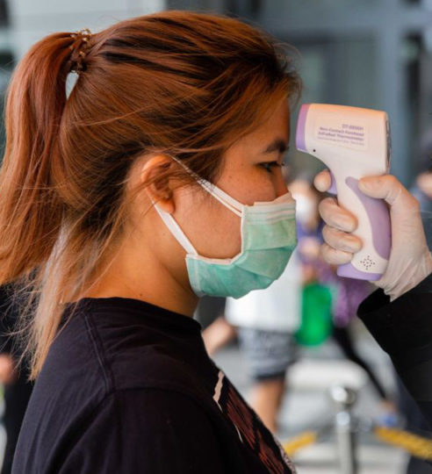
Legal Obligation
Perhaps we MUST process this data
Irish data protection authority:
“…Employers also have a legal obligation to protect their employees under the Safety, Health and Welfare at Work Act 2005 (as amended). This obligation together with Article 9(2)(b) GDPR provides a legal basis to process personal data, including health data, where it is deemed necessary and proportionate to do so...”
Notes:
Not all countries necessarily have such an obligation, will depend on local law. That is more relevant than Vital Interest for most employers.

Slide 19
Functioning with Covid-19
Eight Highlights
Transparency
Lawful basis
Security
Confidentiality
Accountability
Data minimization
Employee duty
Data Sharing

Slide 20
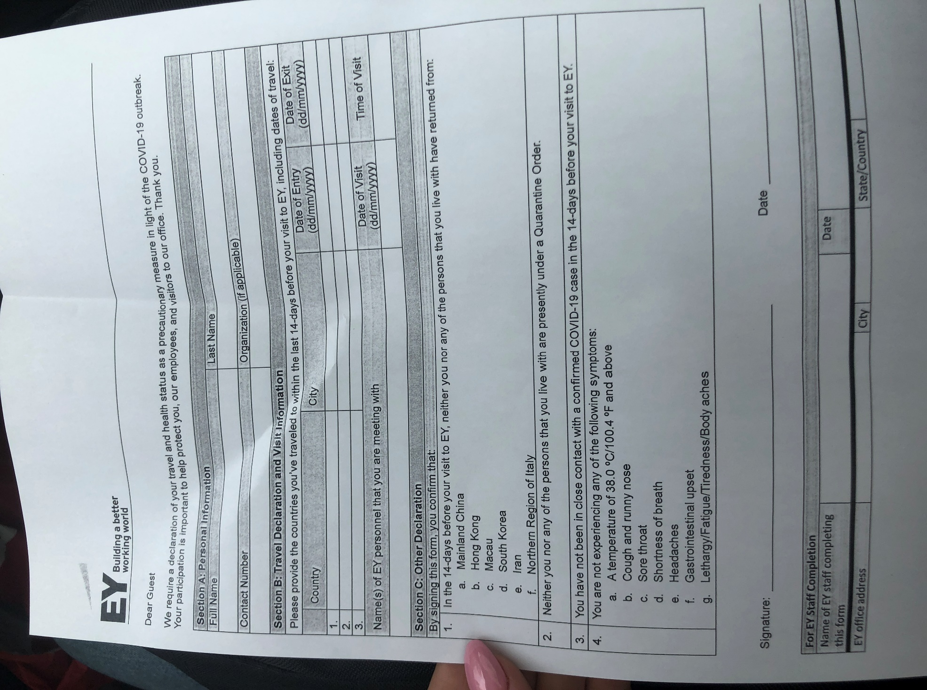
Transparency
Let them know what you’re doing
Notes:
Hungarian Data Protection Authority- https://www.naih.hu/files/NAIH_2020_2586_EN.pdf
In the case of data processing related to legal relationships aimed at the performance of work: a detailed information document has to be drafted and made available to the employees
According to the position taken by the Authority, it follows from the general requirements of conduct applicable to employers and persons in an employment relationship aimed at performing work, thus in particular, the obligation to cooperate and the principles of bona fide action and fairness that employees must inform the employer of any health or other risk affecting the workplace
In relation to the processing of data related to third persons outside any legal relationship aimed at the performance of work (thus, for instance, clients and visitors), the Authority underlines that: in the course of implementing.... action plan particular attention should be paid to weighing the data protection risks of the measures applied in advance and building efficient and adequate channels of communication to facilitate the provision of information to the data subjects .
detailed information and a notice has to be drafted and made available to third persons

Slide 21
Functioning with Covid-19
Eight Highlights
Transparency
Lawful basis
Security
Confidentiality
Accountability
Data minimization
Employee duty
Data Sharing

Slide 22
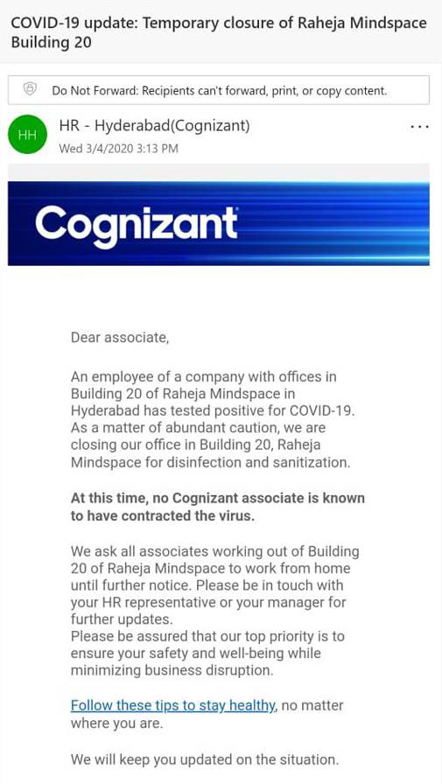
Confidentiality
Who is accessing this data?
Notes:
Cognizant a $25B company; haven’t verified the authenticity of this email; but consider the details, the confidentiality, how it affects employees in the building, or someone who recently travelled and is suspected of carrying.

Slide 23
Functioning with Covid-19
Eight Highlights
Transparency
Lawful basis
Security
Confidentiality
Accountability
Data minimization
Employee duty
Data Sharing

Slide 24
Data minimization
Think twice before you collect
CNIL:
“For example, employers must refrain from collecting in a systematic and generalized manner, or through individual inquiries and requests, information relating to the search for possible symptoms presented by an employee... ”
Notes:
CNIL, the French supervisory authority has also guided employers:
“For example, employers must refrain from collecting in a systematic and generalized manner, or through individual inquiries and requests, information relating to the search for possible symptoms presented by an employee / agent and their relatives. It is therefore not possible to implement, for example:
- mandatory readings of the body temperatures of each employee / agent / visitor to be sent daily to their hierarchy;
- or the collection of medical sheets or questionnaires from all employees / agents”

Slide 25
Functioning with Covid-19
Eight Highlights
Transparency
Lawful basis
Security
Confidentiality
Accountability
Data minimization
Employee duty
Data Sharing

Slide 26
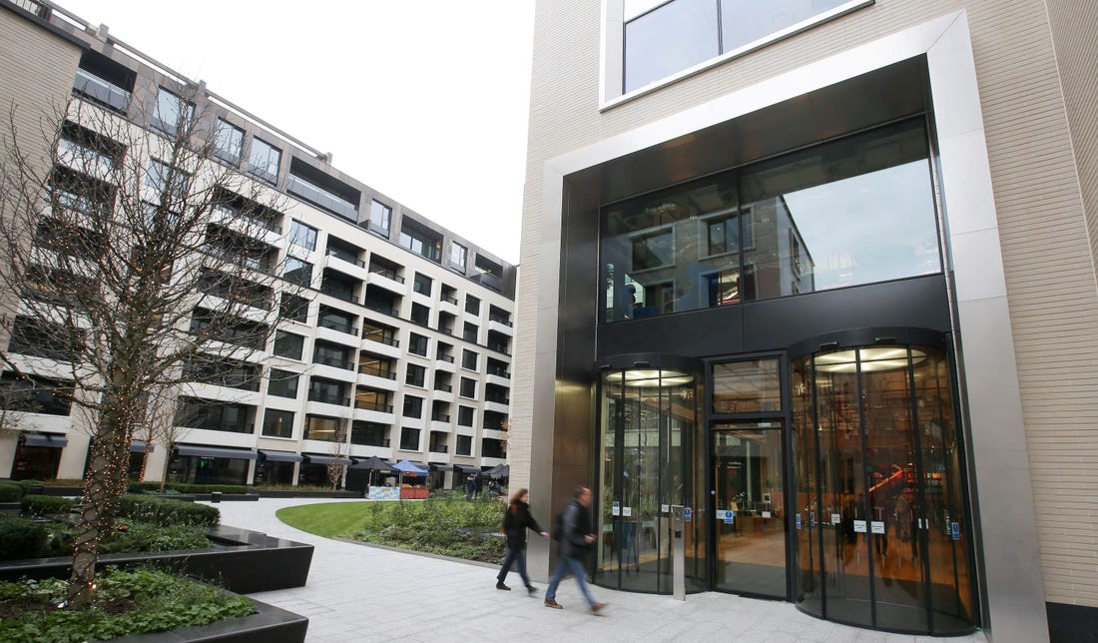
Data sharing
Think twice before you share
Notes:
Data Sharing: if an employer becomes aware of an infected employee or visitor, then although privacy is not the biggest concern, by far, their privacy does need to be protected, with their safety and that of the people around them. Share the data that needs to be shared, but not more than that. Share only the data required to protect the vital interests, or to meet your obligations as an employer. For example, if it is known who had interaction with the infected employee, notify them personally and not the entire company. Or if they were present at one site, there is no need to notify the whole company across other sites, or even countries.
Hungarian DPA: Tests to be carried out by health care professionals or under their professional responsibility and the employer is entitled to be informed only about the results of these examinations

Slide 27
Functioning with Covid-19
Eight Highlights
Transparency
Lawful basis
Security
Confidentiality
Accountability
Data minimization
Employee duty
Data Sharing
Notes:
Employees have their own duty of care.
They need to let an employer know if they’re sick, and can endanger other people. You can remind employees of this duty. It should be obvious really, but in the difficult economic environment, it would not be surprising if people are reticent to share information that can get them sent to sick leave.

Slide 28
Functioning with Covid-19
Eight Highlights
Transparency
Lawful basis
Security
Confidentiality
Accountability
Data minimization
Employee duty
Data Sharing
Notes:
Accountability:
- Document all decision making and specifically the risk assessments and the safeguards implemented to protect the rights and freedoms of the data subjects.
- Depending on which data is being collected, a DPIA is likely required.
These are not so complicated.

Slide 29
Functioning with Covid-19
Eight Highlights
Transparency
Lawful basis
Security
Confidentiality
Accountability
Data minimization
Employee duty
Data Sharing
Notes:
In the rush to do things, we usually get lax about security.
Paper – who has access? Where is it stored?
Emails: where are they accessed from?
Google Forms – not an ideal way to collect information.
Many organizations have not been ready for working from home; they’re cutting a lot of corners, using private equipment and systems. This is creating a lot of security vulnerability, and the Israeli Cyber Authority recently issued a warning to a financial institution that the remote working has led to increased fishing of employees credentials, to enable remote access. Be VERY cautious. Let your people know.

Slide 30
Finishing up
But you should stay in touch
Data & Pandemics
GDPR & Corona
Functioning with Covid
Questions
info@myedpo.com
Notes:
Happy to stay in touch, elaborate and answer queries: arye@myedpo.com

